Slide 1
Deep learning powered ensemble simulation knowledge distillations for surface adhesions
Xianyang Chen
Notes:
Main title: 40 pt. Arial
Presenter Name: 16 pt. Arial
Presenters Title: 16 pt. Arial Italic

Slide 2

Surface adhesion
Adhesion is the tendency of dissimilar particles or surfaces to cling to one another
Ɵ>90
Ɵ<90
Water droplet
Water droplet
A foggy window surface
Hydrophobic surface non-polar interactions
Hydrophilic surface
Polar interactions

Slide 3
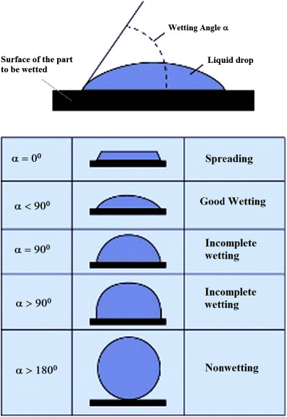
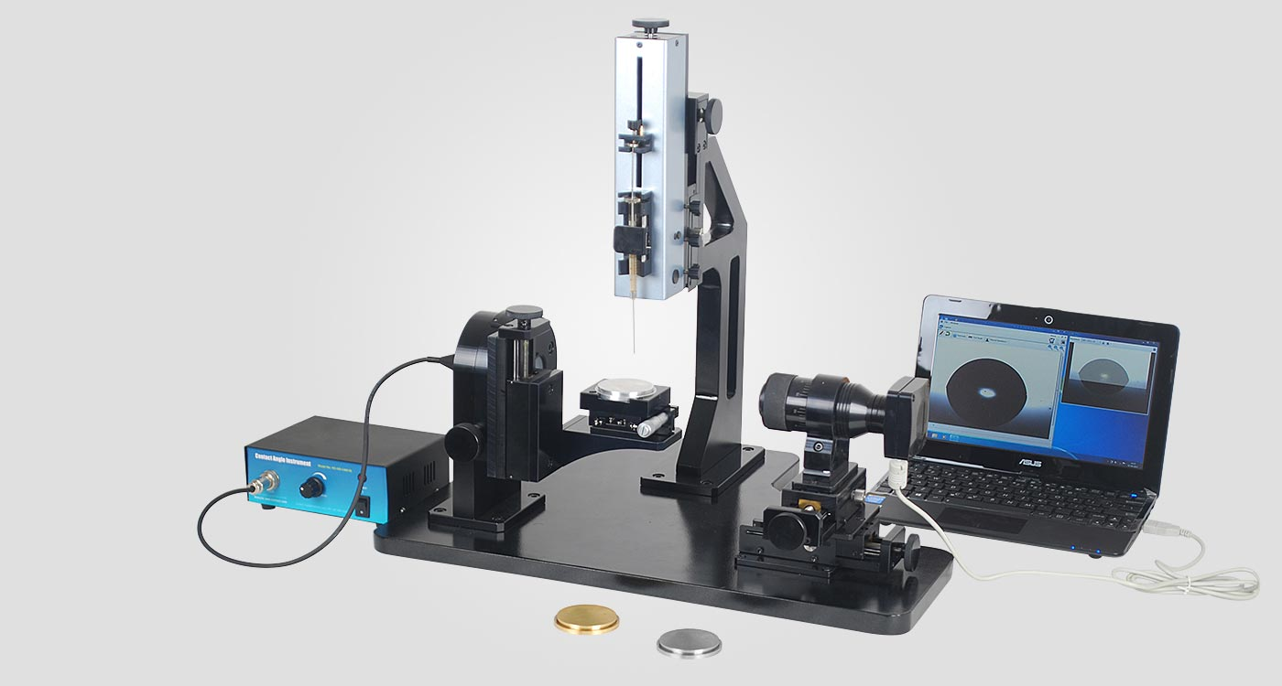
Adhesion Tests
Real scenarios are more complicated due to external factors like humidity or temperature For instance, a surface with good wettability might still be foggy at low temperatures due to low evaporation rate. Testing under various different conditions are required. However, the replication of these conditions might be costly.

Slide 4
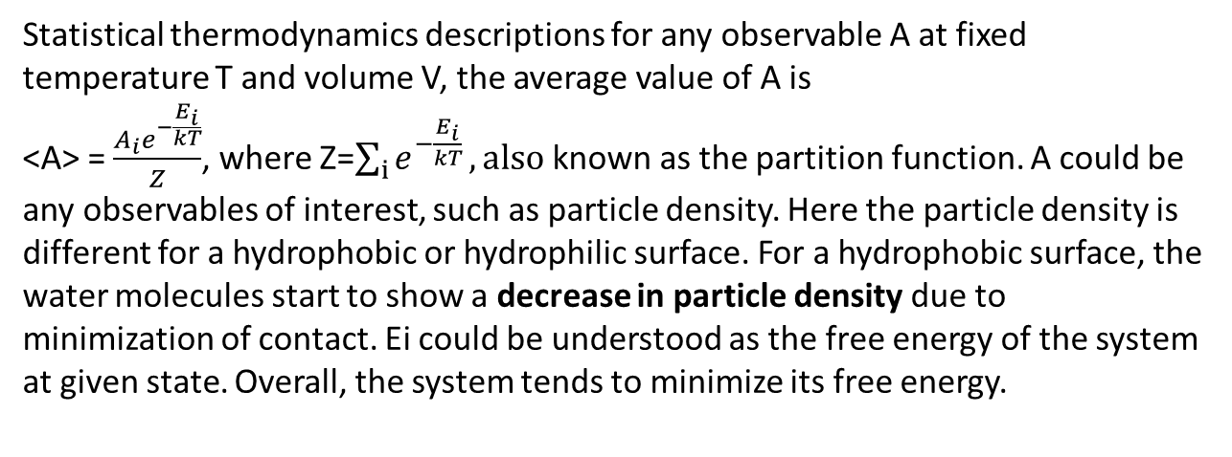
Computer Simulations: robust and effective
Statistical thermodynamics descriptions for any observable A at fixed temperature T and volume V, the average value of A is
<A> = $\frac{{A_{i}e}^{−\frac{E_{i}}{kT}}}{Z}$, where Z=$\sum_{i}{e^{−\frac{E_{i}}{kT}}}, also$ known as the partition function. A could be any observables of interest, such as particle density. Here the particle density is different for a hydrophobic or hydrophilic surface. For a hydrophobic surface, the water molecules start to show a decrease in particle density due to minimization of contact. Ei could be understood as the free energy of the system at given state. Overall, the system tends to minimize its free energy.

Slide 5

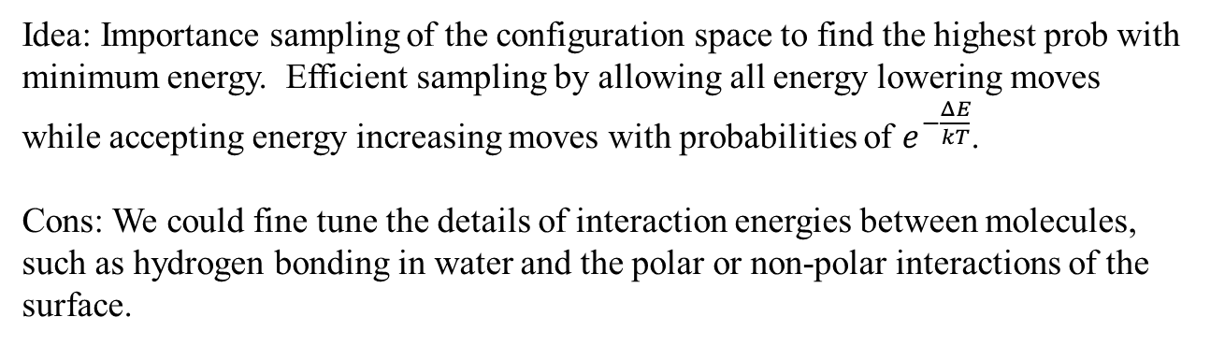
Simulation: Monte Carlo
Idea: Importance sampling of the configuration space to find the highest prob with minimum energy. Efficient sampling by allowing all energy lowering moves while accepting energy increasing moves with probabilities of $e^{−\frac{ΔE}{kT}}$.
Cons: We could fine tune the details of interaction energies between molecules, such as hydrogen bonding in water and the polar or non-polar interactions of the surface.

Slide 6
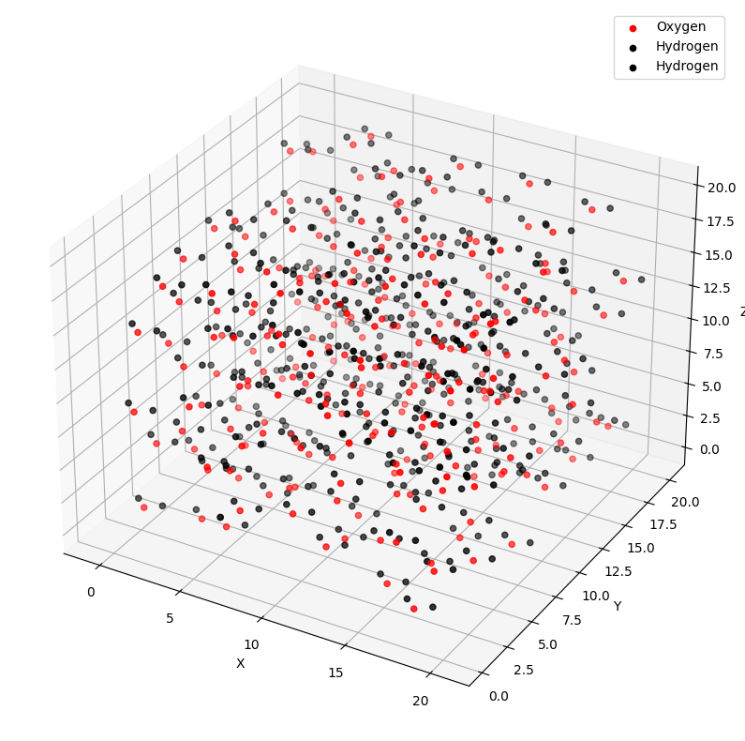
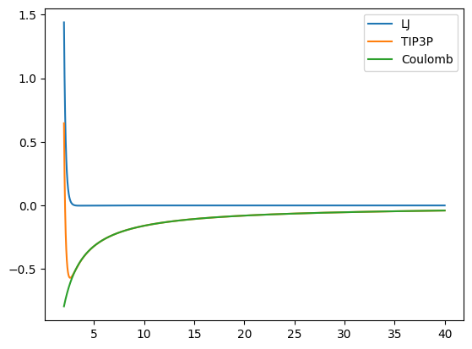
Water surface simulation design: water interactions
Interaction potential between water molecules

Slide 7
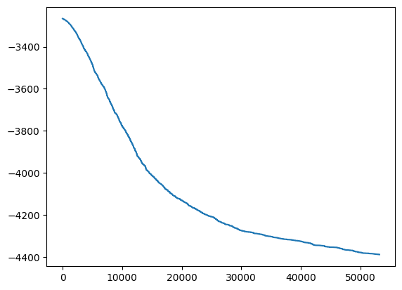
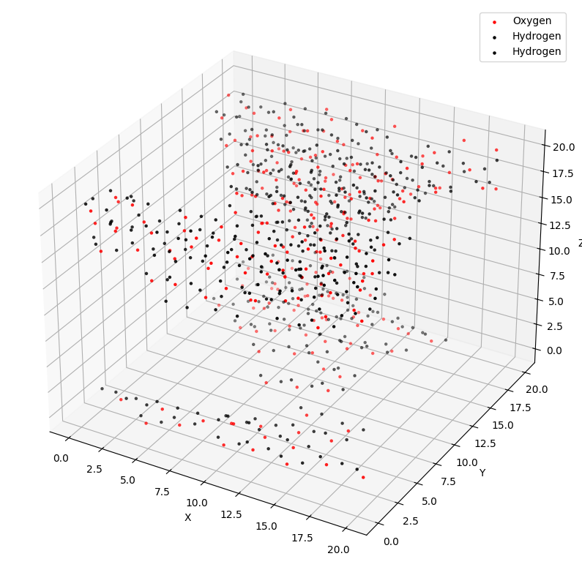
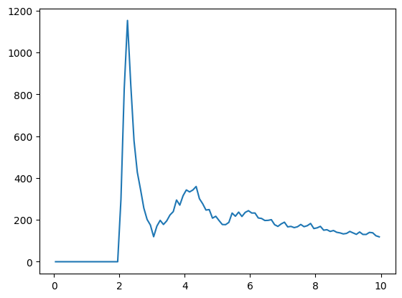
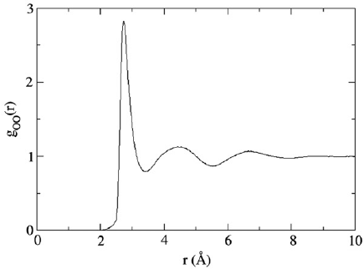
Water surface simulation design: equilibration for water
NVT canonical ensemble
Results validations

Slide 8
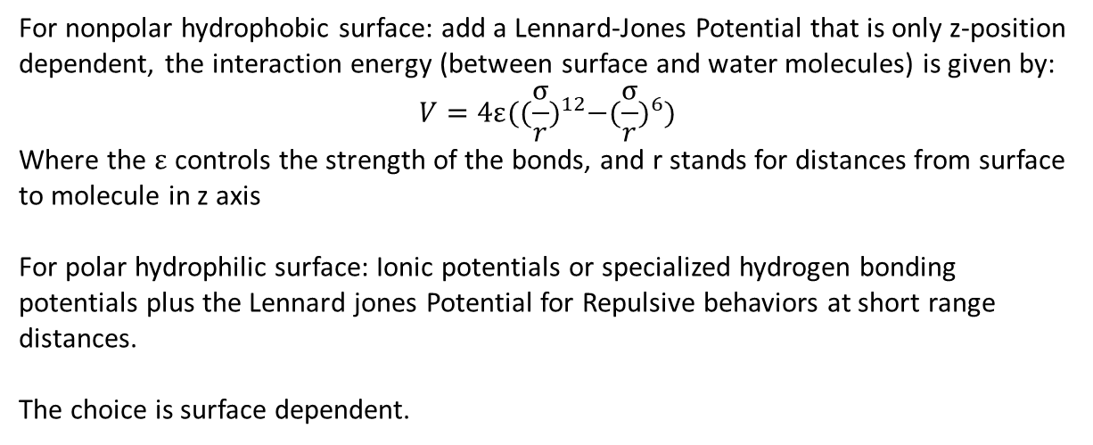
Simulation: Surface Interactions
For nonpolar hydrophobic surface: add a Lennard-Jones Potential that is only z-position dependent, the interaction energy (between surface and water molecules) is given by:
$$V=4ε({(\frac{σ}{r})}^{12}−{(\frac{σ}{r})}^{6})$$
Where the $ε$ controls the strength of the bonds, and r stands for distances from surface to molecule in z axis
For polar hydrophilic surface: Ionic potentials or specialized hydrogen bonding potentials plus the Lennard jones Potential for Repulsive behaviors at short range distances.
The choice is surface dependent.

Slide 9
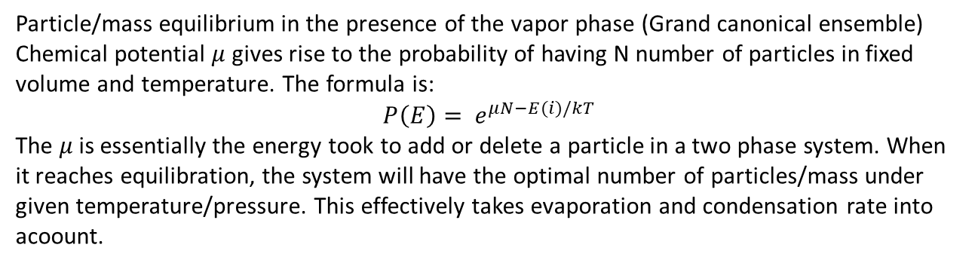
Evaporation/condensation kinetics modelling (on going now)
Particle/mass equilibrium in the presence of the vapor phase (Grand canonical ensemble)
Chemical potential $μ$ gives rise to the probability of having N number of particles in fixed volume and temperature. The formula is:
$$P\left(E\right)= e^{μN−E(i)/kT}$$
The $μ$ is essentially the energy took to add or delete a particle in a two phase system. When it reaches equilibration, the system will have the optimal number of particles/mass under given temperature/pressure. This effectively takes evaporation and condensation rate into acoount.

Slide 10
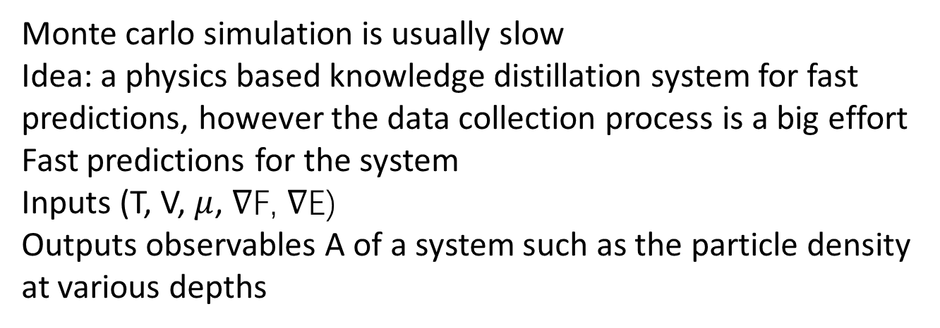
Deep learning model (On going)
Monte carlo simulation is usually slow
Idea: a physics based knowledge distillation system for fast predictions, however the data collection process is a big effort
Fast predictions for the system
Inputs (T, V, $μ$, ∇F, ∇E)
Outputs observables A of a system such as the particle density at various depths

Slide 11
Related work:
https://www.researchgate.net/profile/Marian-Zenkiewicz/publication/40804787_Methods_for_the_calculation_of_surface_free_energy_of_solids/links/02e7e5224628190bef000000/Methods-for-the-calculation-of-surface-free-energy-of-solids.pdf Surface free energy
https://www.nature.com/articles/s42254-021-00314-5 Physics informed deep learning
For more info about monte Carlo see GCMC techniques and metropolis algorithm

